Slide 1
T I T L E
UART Communication System
Serial Caravan Project
Digital System Design
Team Members:
Person 1 – Om Gupta
Person 2 – Nikhil Saini
Person 3 - Painter Kaushalya
Person 4 – Adarsh Upadhyay

Slide 2
TASKS
Person 1 – Theory & Baud Generator
Person 2 – UART Transmitter
Person 3 – UART Receiver
Person 4 – Integration & Testbench

Slide 3
O B J E C T I V E
• Design UART Transmitter and Receiver
• Implement baud rate generator
• Perform serial communication
• Verify functionality using testbench

Slide 4
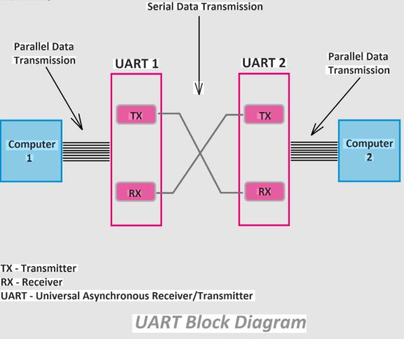

Slide 5
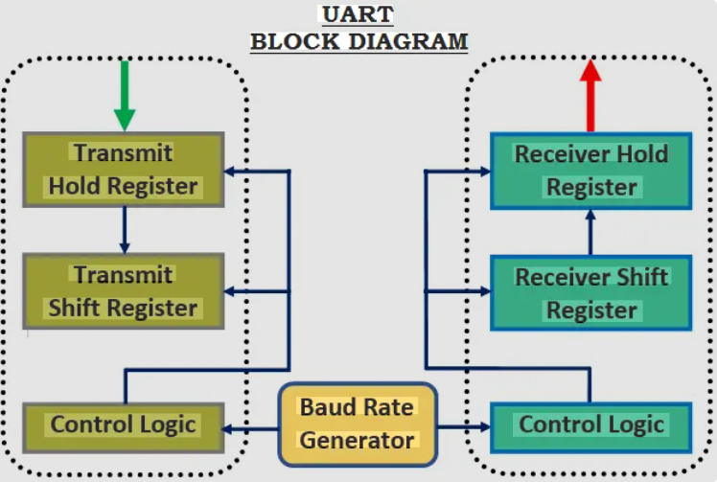

Slide 6
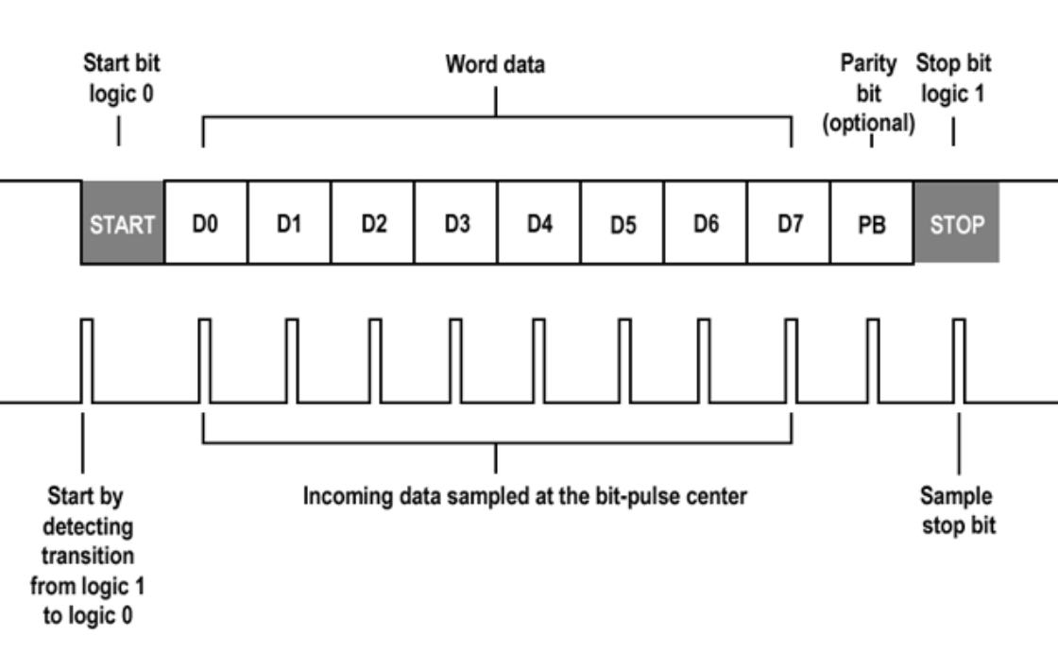
UART FRAME FORMAT
Start Bit | Data (8 bits) | Parity | Stop Bit 0 | LSB → MSB | P |

Slide 7
BAUD RATE CALCULATION
System Clock = 50 MHz
Baud Rate = 9600(Variable)
Divider = 50,000,000 / 9600 ≈ 5208

Slide 8
UART TRANSMITTER
IDLE
↓
START
↓
DATA
↓
PARITY
↓
STOP

Slide 9
UART RECEIVER FSM
FSM States:
IDLE
↓
START
↓
DATA
↓
PARITY
↓
STOP
↓
DONE
.

Slide 10
TESTBENCH STRATEGY
• Clock generation
• Reset initialization
• Test data application
• Waveform capture

Slide 11
RESULTS & WAVEFORMS
• Correct serial transmission
• Data received correctly
• Parity verified
• rx_done asserted

Slide 12
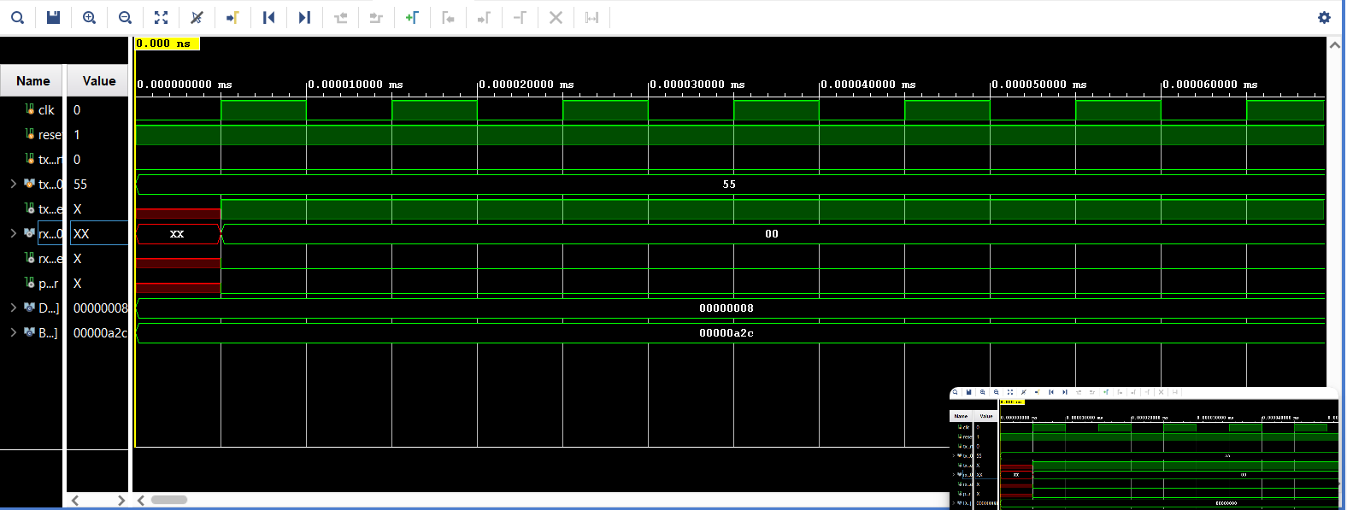

Slide 13
.
FEATURES
PARITY BIT
Variable BaudRates
Variable Databits

Slide 14
CONCLUSION
UART Serial Caravan system was successfully designed, integrated, and verified using simulation and waveform analysis.

Slide 15
Thank You.

